Slide 1


Uddipan Mitra
Sep 07th, 2021

Slide 2

Outline
Executive Summary
Introduction
Methodology
Results
Conclusion
Appendix

Slide 3
Executive Summary
Summary of methodologies
Web Scrapping, Data Wrangling
Exploratory Data Analysis with Visualization and SQL
Interactive Visual Analytics with Folium lab
Interactive Dashboards with Plotly Dash
Prediction using Machine Learning
Summary of all results
Using all the methodologies, we can idealize that the launch success rate has got on the incremental mode for the last 4 years starting from 2017.

Slide 4
Introduction
Project background and context
In this assignment, we are predicting if the Falcon 9 first stage will land successfully
Problems you want to find answers
Which launch sites have more successful launch rates.
Which years have better launch successful rates.
Whether Payload mass can have impacts on the launch success rates.
Which classifier model gives better prediction in terms of launch success rates.

Slide 5


Slide 6
Methodology
Executive Summary
Data collection methodology:
Data has been collected from the Wikipages of List of Falcon 9 and Falcon Heavy launches. Once the HTTP response was received, a Beautiful Soup object was created to parse the response object.
Perform data wrangling
The data was processed using a pandas object which read the .csv file, thereby assigning it into a dataframe one.
Perform exploratory data analysis (EDA) using visualization and SQL
Perform interactive visual analytics using Folium and Plotly Dash
Perform predictive analysis using classification models
The processed data is Standardized.
The data is split into training and test sets with 80% weightage on the training set.
Using a classifier object, the training data set is trained and accuracy on the validation data is performed.
Finally, accuracy on the test data is retrieved and by plotting a confusion matrix, we can distinguish between different classes.

Slide 7
Data Collection
Describe how data sets were collected.
You need to present your data collection process use key phrases and flowcharts

Slide 8
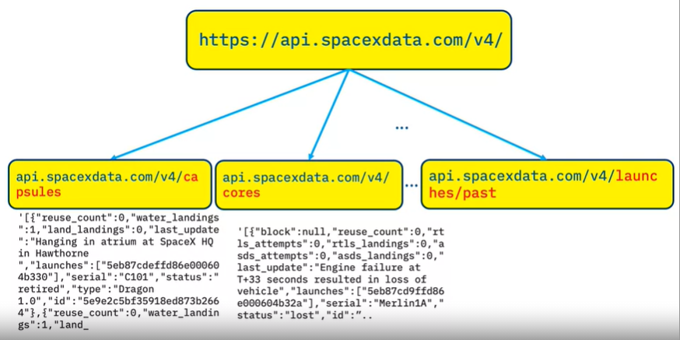
Data Collection – SpaceX API
Present your data collection with SpaceX REST calls using key phrases and flowcharts
Add the GitHub URL of the completed SpaceX API calls notebook (must include completed code cell and outcome cell), as an external reference and peer-review purpose
Place your flowchart of SpaceX API calls here
https://github.com/r-spacex/SpaceX-API

Slide 9
Data Collection - Scraping
Present your web scraping process using key phrases and flowcharts
Add the GitHub URL of the completed web scraping notebook, as an external reference and peer-review purpose
SpaceX Web Scrapping Notebook_Github

Slide 10
Data Wrangling
Describe how data were processed
Load Space X dataset
Identify and calculate the percentage of the missing values in each attribute
Identify which columns are numerical and categorical
Calculate the number of launches on each site
Calculate the number and occurrence of each orbit
Calculate the number and occurrence of mission outcome per orbit type
Create a landing outcome label from Outcome column
Determine the success rate
Add the GitHub URL of your completed data wrangling related notebooks, as an external reference and peer-review purpose
SpaceX Data Wrangling Notebook_GitHub

Slide 11
EDA with Data Visualization
Visualize the relationship between Flight Number and Launch Site – With increase of Flight number for each launch site, the success rate has improved.
Visualize the relationship between Payload and Launch Site, Visualize the relationship between Payload and Orbit type – With increase of Payload Mass (kg), the success rate has improved.
Visualize the relationship between success rate of each orbit type - Suceess rate is most for ES-L1, GEO, HEO & SSO while SO doesn't hav any success.
Visualize the launch success yearly trend - sucess rate since 2014 kept increasing till 2020.
Add the GitHub URL of your completed EDA with data visualization notebook, as an external reference and peer-review purpose
EDA with Data Visualization Notebook_GitHub

Slide 12
EDA with SQL
Display the names of the unique launch sites in the space mission - SELECT DISTINCT(LAUNCH_SITE) FROM SPACEXTBL
Display 5 records where launch sites begin with the string 'CCA' - SELECT * FROM SPACEXTBL WHERE LAUNCH_SITE LIKE 'CCA%' LIMIT 5
Display the total payload mass carried by boosters launched by NASA (CRS) - SELECT SUM(PAYLOAD_MASS__KG_) AS TOTAL_PAYLOAD_MASS FROM SPACEXTBL WHERE CUSTOMER= 'NASA (CRS)'
Display average payload mass carried by booster version F9 v1.1 - SELECT AVG(PAYLOAD_MASS__KG_) AS AVERAGE_PAYLOAD_MASS FROM SPACEXTBL WHERE BOOSTER_VERSION LIKE 'F9 v1.1'
List the date when the first succesful landing outcome in ground pad was achieved - SELECT MIN(DATE) AS FIRST_SUCCESSFUL_LANDING_DATE FROM SPACEXTBL WHERE LANDING__OUTCOME='Success (ground pad)'
List the names of the boosters which have success in drone ship and have payload mass greater than 4000 but less than 6000 - SELECT BOOSTER_VERSION FROM SPACEXTBL WHERE LANDING__OUTCOME='Success (drone ship)' AND PAYLOAD_MASS__KG_ BETWEEN 4000 AND 6000
List the total number of successful and failure mission outcomes - SELECT COUNT(MISSION_OUTCOME) AS Total_count_of_mission_outcomes FROM SPACEXTBL
List the names of the booster_versions which have carried the maximum payload mass. Use a subquery - SELECT BOOSTER_VERSION,PAYLOAD_MASS__KG_ FROM SPACEXTBL WHERE PAYLOAD_MASS__KG_=(SELECT MAX(PAYLOAD_MASS__KG_) FROM SPACEXTBL)
List the failed landing_outcomes in drone ship, their booster versions, and launch site names for the in year 2015 - SELECT LANDING__OUTCOME, BOOSTER_VERSION, LAUNCH_SITE FROM SPACEXTBL WHERE LANDING__OUTCOME LIKE '%drone%' AND YEAR(DATE)=2015
Rank the count of landing outcomes (such as Failure (drone ship) or Success (ground pad)) between the date 2010-06-04 and 2017-03-20, in descending order - SELECT LANDING__OUTCOME, COUNT(LANDING__OUTCOME) AS COUNT_OF_LANDING_OUTCOMES FROM SPACEXTBL WHERE DATE BETWEEN '2010-06-04' AND '2017-03-20' GROUP BY LANDING__OUTCOME ORDER BY COUNT(LANDING__OUTCOME) DESC
Add the GitHub URL of your completed EDA with SQL notebook, as an external reference and peer-review purpose - EDA with SQL Notebook_GitHub

Slide 13
Build an Interactive Map with Folium
Task 1: Mark all launch sites on a map – Creation of folium.Circle and folium.Marker for each launch site on the site map
Task 2: Mark the success/failed launches for each site on the map - For each launch result in spacex_df dataframe, a folium.Marker has been added to marker_cluster
TASK 3: Calculate the distances between a launch site to its proximities -
- Marking down a point on the closest railway using MousePosition and calculating the distance between the railway point to the launch site.
- After obtaining its coordinate, creating a folium.Marker to show the distance.
- Drawing a PolyLine between a launch site to the selected.
Add the GitHub URL of your completed interactive map with Folium map, as an external reference and peer-review purpose - Interactive Map with Folium Notebook_GitHub

Slide 14
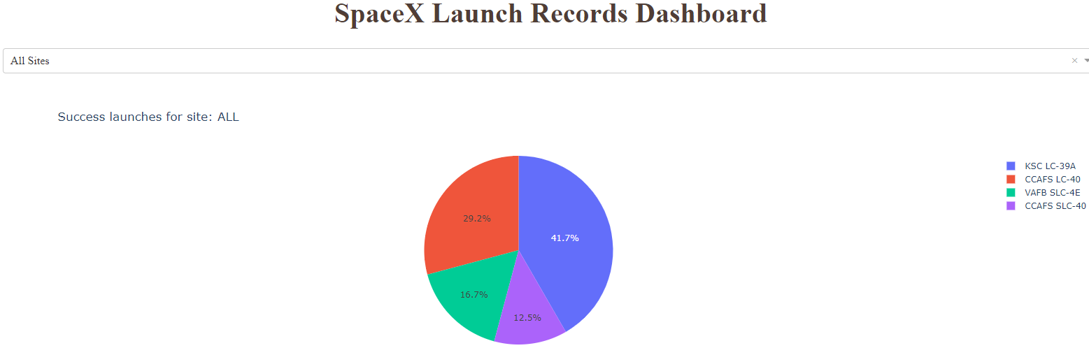
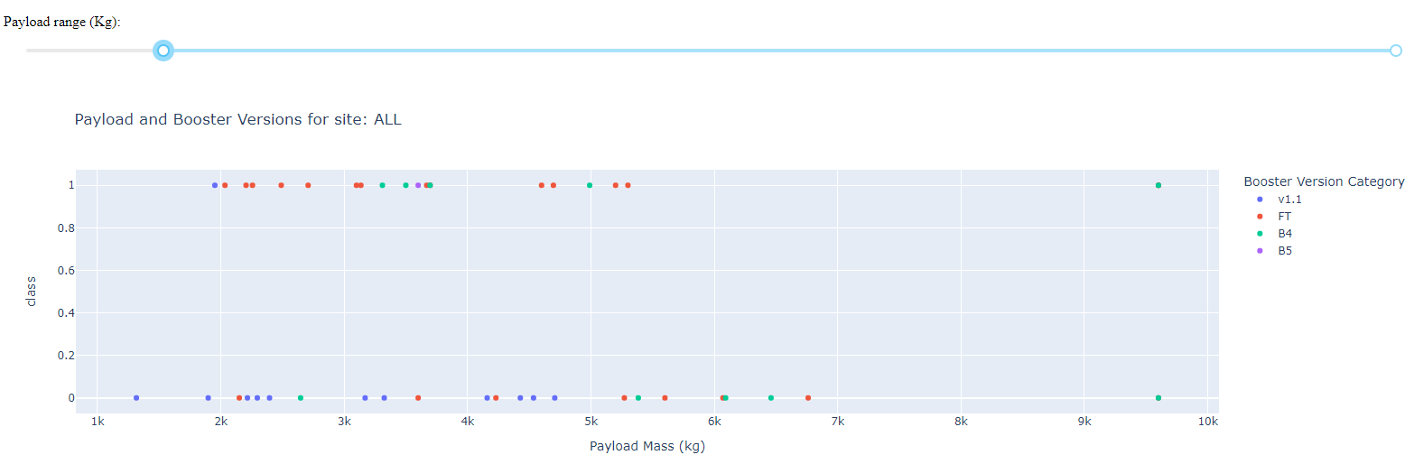
Build a Dashboard with Plotly Dash
Success Launches for the launch sites
Payload and Booster Versions for site
The plots have been visualized to depict how the launch success rate varies for each of the types – be it launch sites, Paylod or Booster versions.
Add the GitHub URL of your completed Plotly Dash lab, as an external reference and peer-review purpose - Dashboard with Plotly Dash Notebook_GitHub

Slide 15
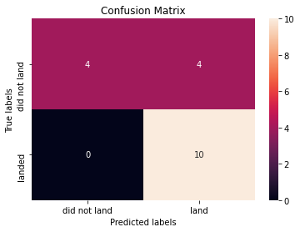
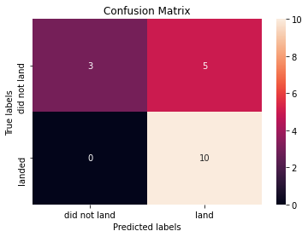
Predictive Analysis (Classification)
Load the data, create a NumPy array from the column Class in data, Standardize the data and split it into train and test data sets. The training dataset should be maximum in volume as compared to the test set.
Fit the object to find the best parameters using a classifier object. We display the best parameters & accuracy on the validation data using the data attribute.
Calculate the accuracy on the test data and plot the confusion matrix for each of the classifier types accordingly.
Here, all the classifier models give near about similar accuracy scores.
Add the GitHub URL of your completed predictive analysis lab, as an external reference and peer-review purpose -
Predictive Analysis (Classification) Notebook_GitHub

Slide 16
Results
Exploratory data analysis results
Interactive analytics demo in screenshots
Predictive analysis results

Slide 17


Slide 18
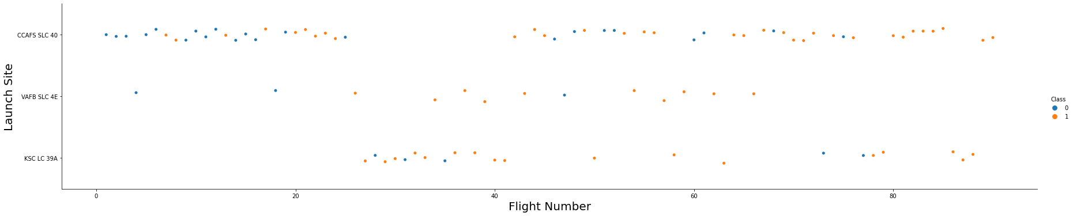
Flight Number vs. Launch Site
With the increase in Flight Number for the launch sites, the success rate becomes more effective.

Slide 19
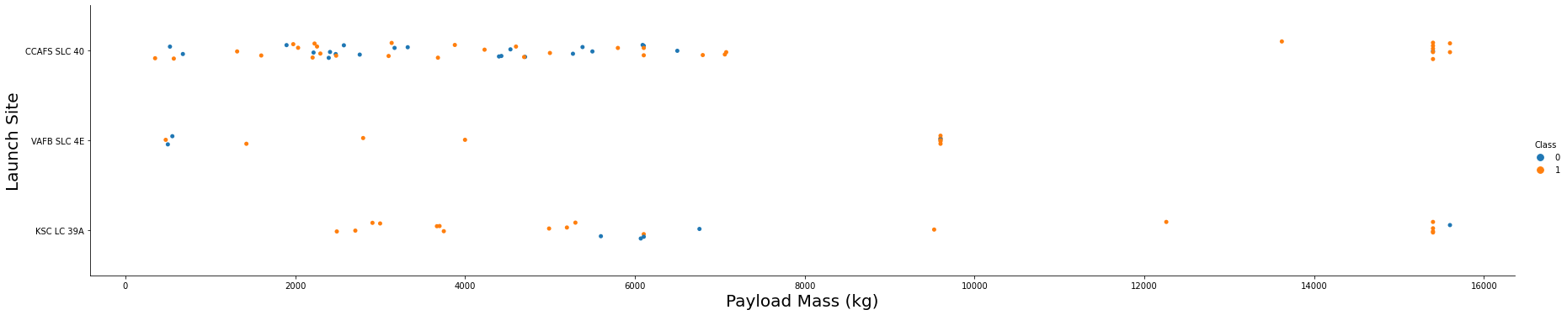
Payload vs. Launch Site
With the increase in Payload Mass for the launch sites, the success rate becomes most effective

Slide 20
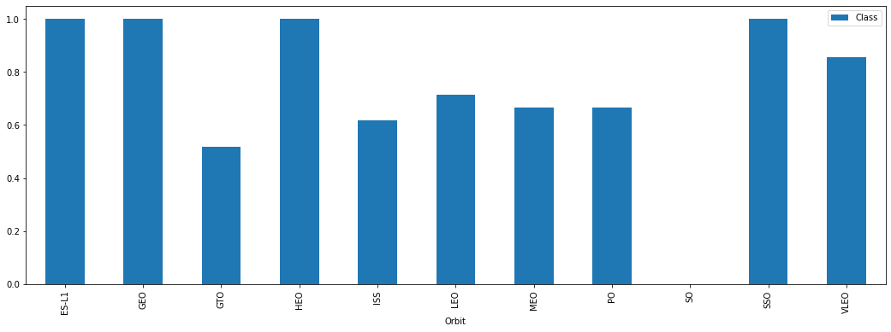
Success Rate vs. Orbit Type
ES-L1, GEO, HEO AND SSO have best success rates while SO has the least.

Slide 21
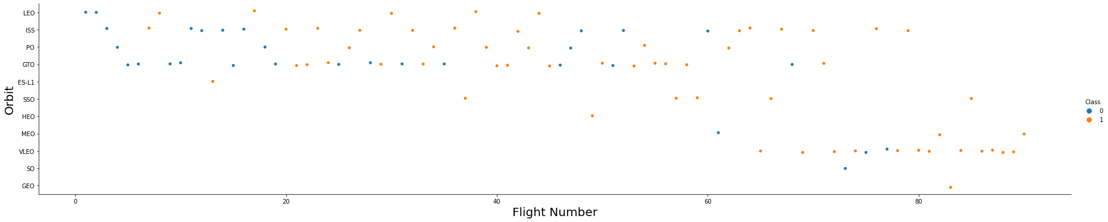
Flight Number vs. Orbit Type
The comparison of Orbit via Flight Number is not a good detector in concluding about the success rates.

Slide 22
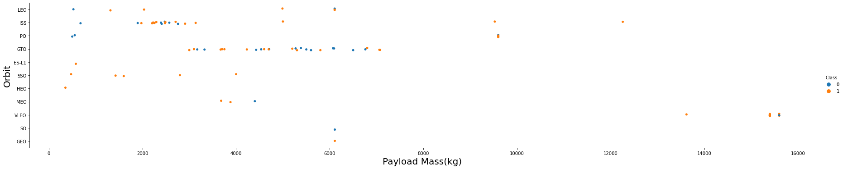
Payload vs. Orbit Type
With the increase in Payload Mass for different Orbit types, the success rate has become more effective.

Slide 23
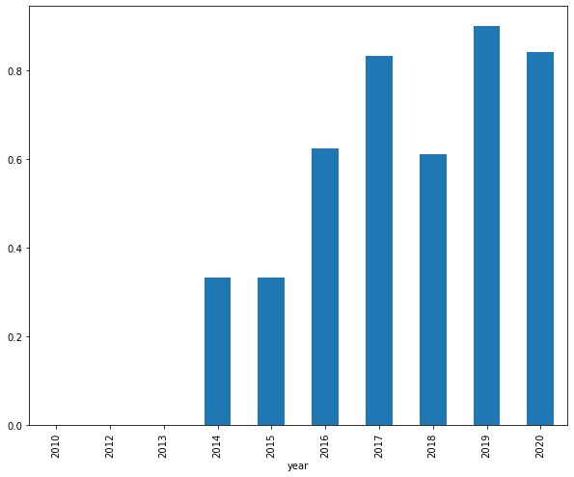
Launch Success Yearly Trend
Success rate since 2014 kept increasing till 2020

Slide 24
All Launch Site Names
Display the names of the unique launch sites in the space mission
launch_site
CCAFS LC-40
CCAFS SLC-40
KSC LC-39A
VAFB SLC-4E

Slide 25
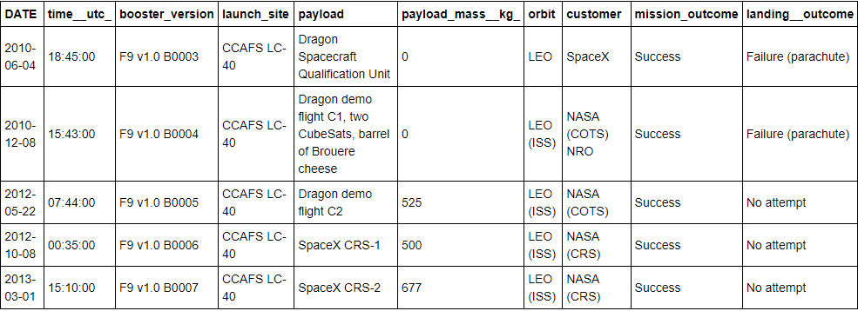
Launch Site Names Begin with 'CCA'
Display 5 records where launch sites begin with the string 'CCA'

Slide 26
Total Payload Mass
Display the total payload mass carried by boosters launched by NASA (CRS)
total_payload_mass
45596

Slide 27
Average Payload Mass by F9 v1.1
Display average payload mass carried by booster version F9 v1.1
average_payload_mass
2928

Slide 28
First Successful Ground Landing Date
List the date when the first succesful landing outcome in ground pad was acheived.
first_successful_landing_date
2015-12-22

Slide 29
Successful Drone Ship Landing with Payload between 4000 and 6000
List the names of the boosters which have success in drone ship and have payload mass greater than 4000 but less than 6000
booster_version
F9 FT B1022
F9 FT B1026
F9 FT B1021.2
F9 FT B1031.2

Slide 30
Total Number of Successful and Failure Mission Outcomes
List the total number of successful and failure mission outcomes
total_count_of_mission_outcomes
101

Slide 31
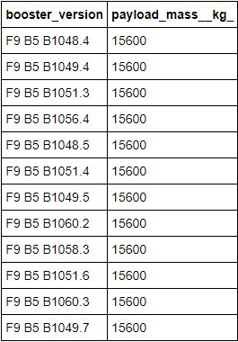
Boosters Carried Maximum Payload
List the names of the booster_versions which have carried the maximum payload mass.

Slide 32
2015 Launch Records
List the failed landing_outcomes in drone ship, their booster versions, and launch site names for the in year 2015
landing__outcome | booster_version | launch_site
Failure (drone ship) | F9 v1.1 B1012 | CCAFS LC-40
Failure (drone ship) | F9 v1.1 B1015 | CCAFS LC-40
Precluded (drone ship) | F9 v1.1 B1018 | CCAFS LC-40

Slide 33
Rank Landing Outcomes Between 2010-06-04 and 2017-03-20
Rank the count of landing outcomes (such as Failure (drone ship) or Success (ground pad)) between the date 2010-06-04 and 2017-03-20, in descending order
landing__outcome | count_of_landing_outcomes
No attempt | 10
Failure (drone ship) | 5
Success (drone ship) | 5
Controlled (ocean) | 3
Success (ground pad) | 3
Failure (parachute) | 2
Uncontrolled (ocean) | 2
Precluded (drone ship) | 1

Slide 34


Slide 35
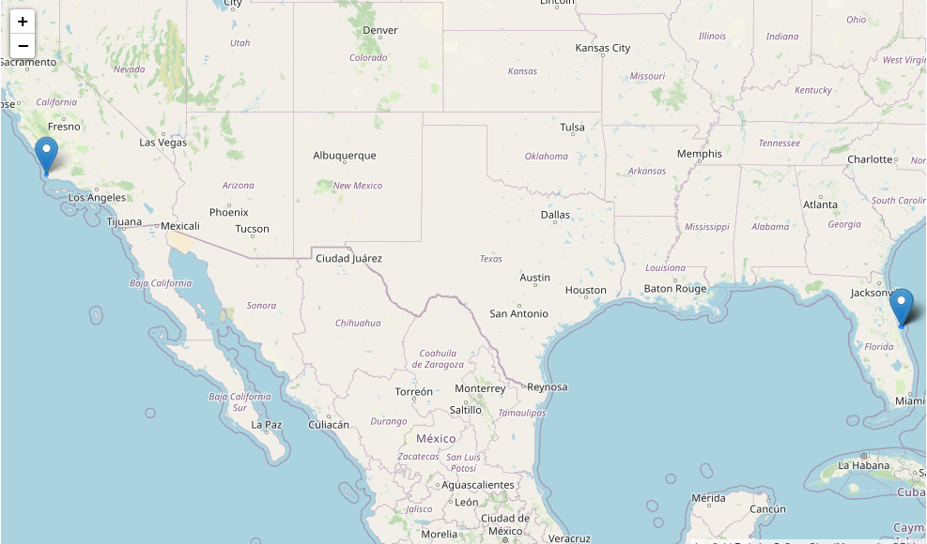
Folium map of launch sites
The launch sites being marked as above

Slide 36
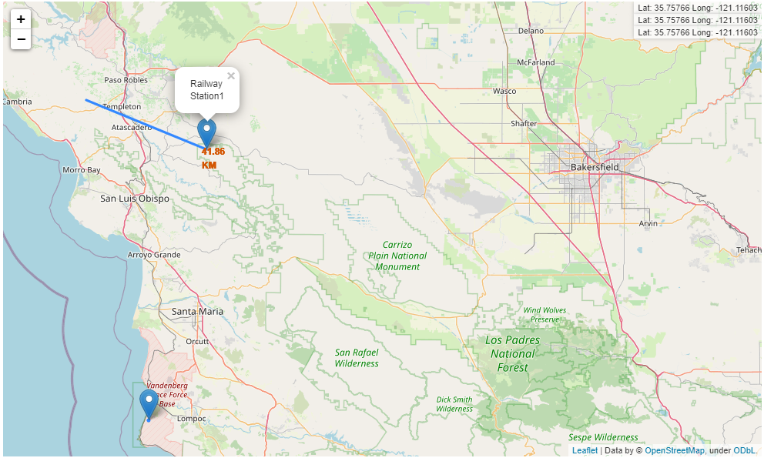
Distances between a launch site to its proximities
As calculated, the distance between a launch site and the closest railway station is 41.86 KM
As calculated, the ditance between a launch site and the closest railway station is 41.86 KM

Slide 37


Slide 38
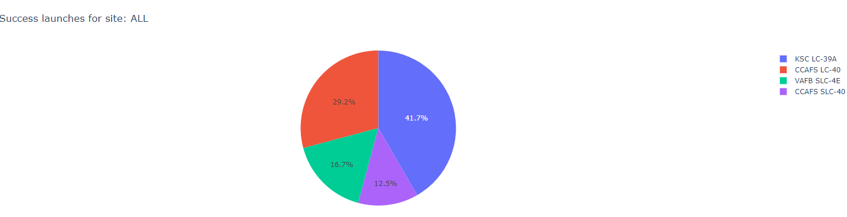
Successful launches for all launch sites
KSC LC-39A LAUNCH SITE has the maximum launch success rate (41.7%) whereas, CCAFS SLC-40 has the least (12.5%) when all the 4 launch sites' success rate values are compared together.

Slide 39
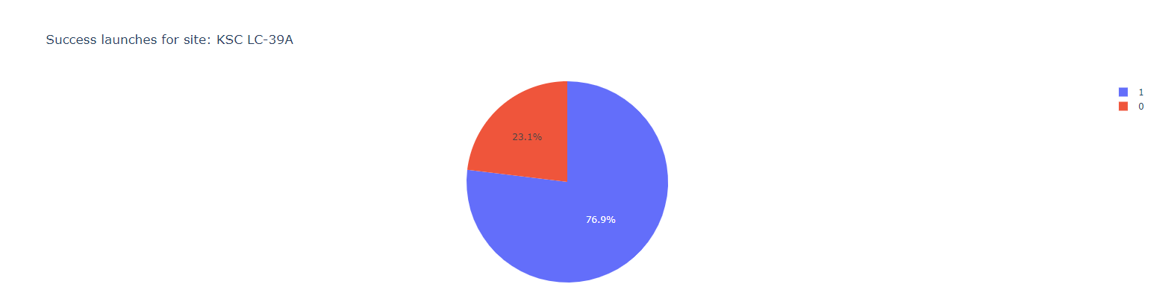
Successful launches for KSC LC-39A
KSC LC-39A launch site has success rate (76.9%) in 3 out of 4 attempts atleast on an average.

Slide 40
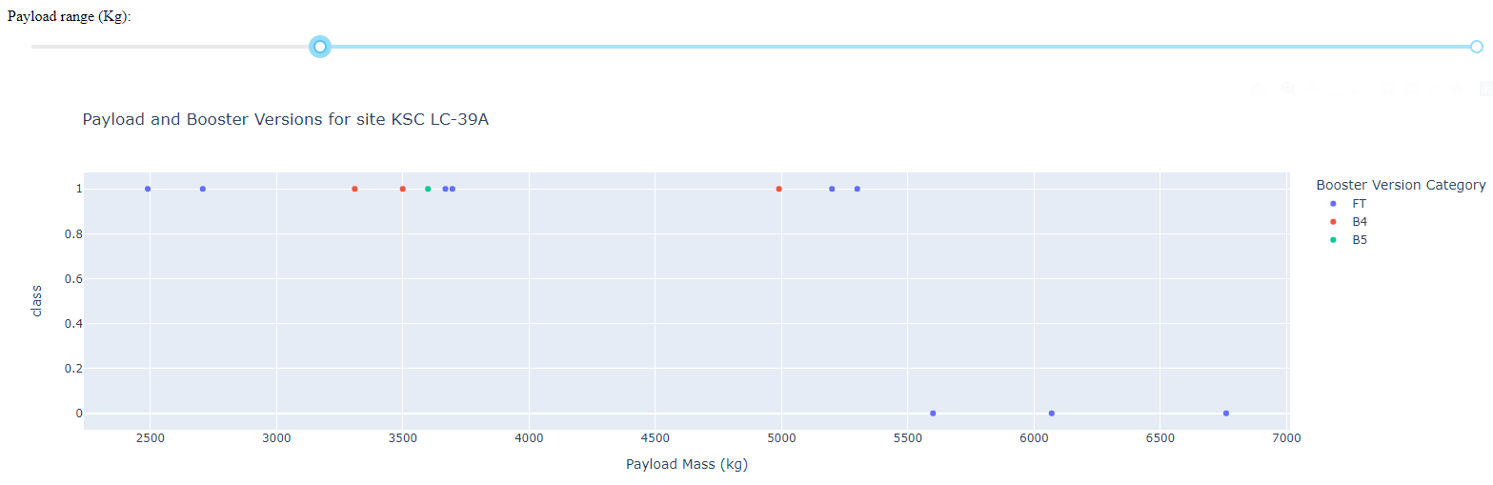
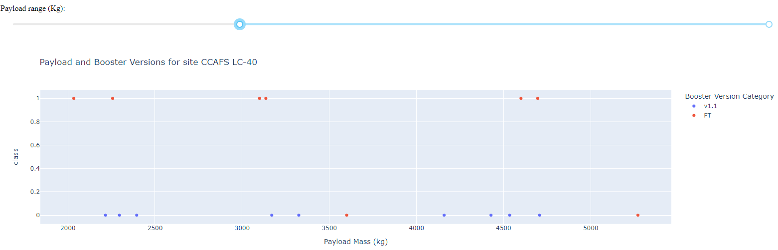
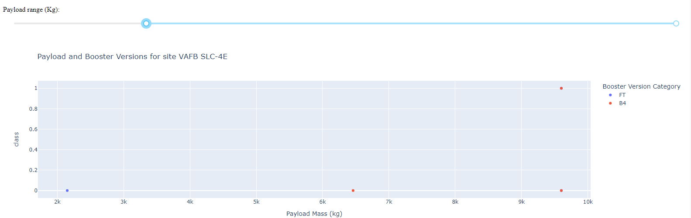
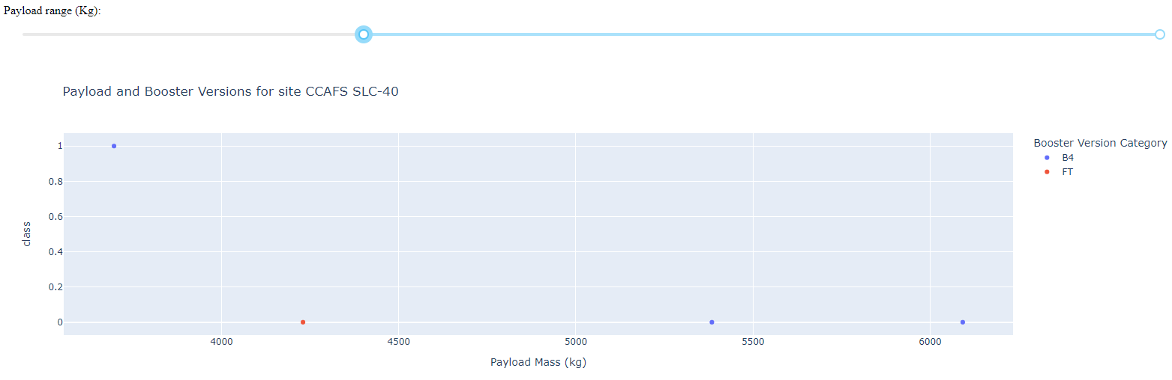
Payload vs. Launch Outcome scatter plot for all sites
For most of the launch sites, the more value the Payload mass has, the less is the number of success rates for differently varied bosster versions in each.

Slide 41


Slide 42
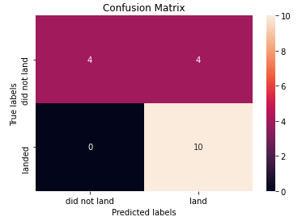
Confusion Matrix
Decision Tree Classifier – The best fitted model
Training data set accuracy: 91.78%
Test Data set accuracy: 77.78%

Slide 43
Conclusions
KSC LC-39A launch site has the maximum launch success rate in comparison to the other launch sites.
Launch success rate since 2014 has been on the incremental mode till date.
ES-L1, GEO, HEO and SSO Orbit types have best success rates while SO has the least.
Decision Tree Classifier can be classified as the best fitted model though other classifier models like Logistic Regression, Support Vector Machines and KNN are also nearby effective.

Slide 44
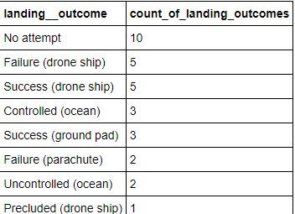
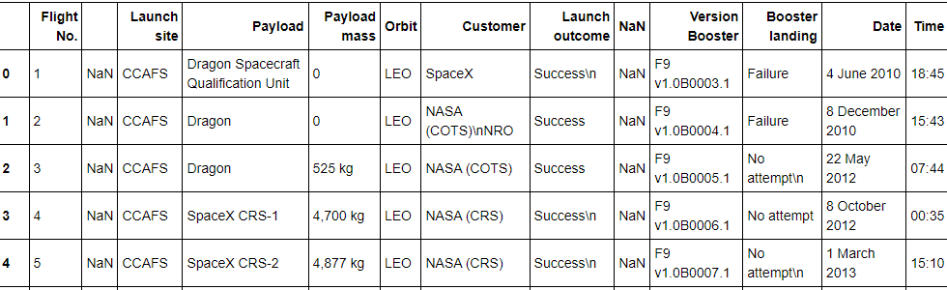
Appendix
%sql SELECT LANDING__OUTCOME, COUNT(LANDING__OUTCOME) AS COUNT_OF_LANDING_OUTCOMES FROM SPACEXTBL WHERE DATE BETWEEN '2010-06-04' AND '2017-03-20' GROUP BY LANDING__OUTCOME ORDER BY COUNT(LANDING__OUTCOME) DESC
df= pd.DataFrame({ key:pd.Series(value) for key, value in launch_dict.items() }) df

Slide 45


